Slide 1
Chapter Eleven Temporality and the Living Present

Slide 2
The Enactive Approach
Time-consiousness as dynamicsystems (Gallagher and Varela 2003)
Neurophenomenology – temporal dynamics and brain activity (Lutz and Thompson 2003)
Page 312

Slide 3
Experience and the Flow of Action
Examples of my everyday life actings as for example, washing, dressing, eating, playing guitar, and etc.
Temporal structure of experience.
Merleau-Ponty idea of: Bodily intentionality or motor intentionality charachterizes habitual actions and bodily skills.
Dreyfus calls it absorbed skillful coping – however, it does not have a ’subject-object’ struture.
Skillful coping, I don’t need a mental representation of my goal. Rather acting is experienced as a steady flow of skillful activity in response to one’s sense of the situation.
Complex relation between embodied action and the temporal structure of experience
Husserl and Merleau-Ponty: Kinesthetic, bodily movement intentional structure as ”I can” rather than ”I think”
Page 312-313

Slide 4
Nonreflective ”I can”
Consciousness is not a detached observation or reflective-awareness, but rather a nonreflective attunement to the interplay of action and milieu. Finally, this interplay has a certain temporal form or structure.
Each maneuver undertaken by the player modifies the character of the field and establishes in it new lines of force in which the action in turn unfolds and is accomplished, again altering the phenomenal field – Merleau-Ponty.
In skillful coping, we experience our activity as a steady flow.
Page 314

Slide 5
Dynamic Interactive Temporal Structure
Perception-Action Loop
Absorbed Skillful Coping
No Subject-Object Structure
Passive and Intransitive
Life-World
Nonreflective ”I can” structure
Prereflective Self-Awareness Animates Skillful Coping
Page 314 - 317

Slide 6
Time-Consciousness and Prereflective Self-Awarenes
Objects persist and undergo change and transformation; processes unfold and develop in time; and events arise, endure, and end.
As Merleau-Ponty says, the perceptual synthesis is a temporal synthesis.
The tree as remembered, the tree as a perceived, and the tree as antcipated are all intended as one and the same tree.
Husserl’s account of the structure of time-consciousness is meant to explain both sorts of awareness – how we can be aware of temporal objects (outer time-consciousness) and how we can be aware of our own ebbing and flowing experiences (inner time-consciousness).
Page 318 -

Slide 7
Consciousness of the Present
Consciousness of the present moment must rather be an experience of the present as having temporal width.
Duration-block.
Gallagher 1998. More precisely, the duration-block of the present moment is an intentional object of time-consciousness.
According to Husserl, time-consciousness has a threefold structure; primal impression, retention, and protention.
page 318 - 319

Slide 8
Now-Phase Structure
The retention and the protention are not past or future in respect to the primal impression, but ’simultaneous’ with it.
CBA
O1
O2
O3
The relation between the primal impression-retention-protention and the different temporal phases of the object - Dan Zahavi.
page 319-

Slide 9
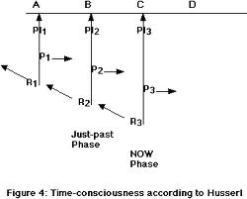
The Structure of Time-Consciousness
Page 320 - 321

Slide 10
Two types of Intentionality
The first type is the unification of consciousness over time. This unification happens automatically because retention retains the previous phases of consciousness, specifically their interlocking primal impressions, rentention, and protentions. Husserl calls this retention of consciousness the horizonal or lengthwise intentionality of time-consciousness.
The second type of intentionality ensures the continuity of the experienced temporal object. This intentional process also happens automatically, because the retention of consciousness necessarily includes the retention of the intentional object belonging to the previous phases of consciousness. Husserl calls this type of intentionality the transverse intentionality of time-consciousness.
page 322

Slide 11
Time-consciousness and prereflective self-awareness
Each phase of phase of experience retains not only the intentional contents of the just-past experience, but also the just-past phase of the experience itself, including its retentional-impressional-protentional structure.
Three levels of temporality;
External temporality (such as melodies)
Experiences of those objects or intentional acts directed at them.
Experiences of those intentional acts themselves.
Page 322 - 323

Slide 12
Inner time-consciousness
Through inner time-consciousness one is aware not only of the stream of consciousness (prereflective self-awareness), but also of the acts as demarcated temporal objects in subjective time (reflective self-awareness) and of transcendent object in objective time (intentional consciousness – Zahavi .
Inner time-consciousness is simply another name for the prereflective self-awareness of our experience, a streaming self-awareness that is not itself an intentional act, a temporal unit, or an immanent object (Hua 10/127), but an intrinsic and irrelational feature of our consciousness.
Inner time-consciousness the absolute consciousness or the absolute flow is supposed to be the deepest level of time-consciousness.

Slide 13
The Absolute Flow
The absolute flow is self-constituting, thanks to its horizontal or lengthwise intentionality. The flow of consciousness retains and protends itself – including retaining its protending of itself and protending its retaining of itself – and is in this way self-unifying.
The absolute flow is self-organizing.
William James, in experiencing the silence before the thunder, we do not deed to have first an experience of silence and then an experience of thunder – but thunder breaking upon silence and contrasting with it.
Invariant structure of time-consciousness, which presumably constitutes the listening experience as such in any possible situation.
Page 325 -

Slide 14
Summary of Prereflective Self-Awareness and Inner Time-Consciousness
The absolute flow of experiencing simply is the pre-reflective self-manifistation of our experiences – Zahavi.
Put another way, the structure of inner time-consciousness – primal impression-retention-protention – is exactly the structure of prereflective self-awareness and also precisely the absolute flow.
The absolute flow is the standing-streaming living present.
The living present is streaming because it is the continuous transformation (intentional modification) of the about-to-happen into the happening into the just-happened.
Page 328 -

Slide 15
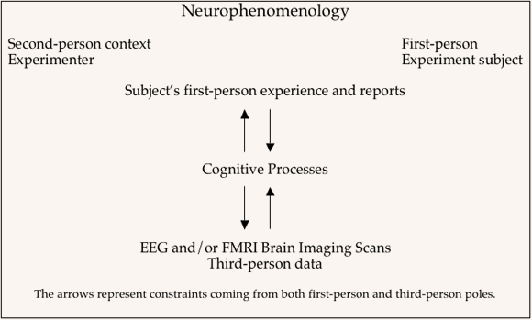
Neurophenomenology and Time-Consciousness
Page 329 -

Slide 16
Varela’s Strategy in study time-consciousness
Find a common structural level of description that captures the dynamics of both the impressional-retentional-potentional flow of time-consciousness and the large-scale neural processes thought to be associated with consciousness.
Neuroscientists also increasingly believe that moment-to-moment, transitive (object-directed) consciousness is associated with dynamic, large-scale neural activity rather than any single brain region or structure.
This problem is known as the large-scale integration problem – Varela et al. 2001.
Page 330 -

Slide 17
Time-Scales
Duration of the 1 scale: 250 – 500 ms (large-scale integration)
1/10 scale – elementary sensorimotor and neural events of 10 – 100 ms.
10 scale – descriptive and narrative assessments involving memory.
Page 331 -

Slide 18
Phase synchrony
Quantitative and qualitative differences between the perception and no-perception conditions. Between 200 and 260 ms, a first period of significant synchronization was observed in the perception condition but not in the no-perception condition.
Self-organizing neurodynamics. According to Varela, this dynamics can be described as having a retentional-protentional structure.
Page 332 - 335

Slide 19
Dynamical Models
The dynamical models and the data shows that this synchronization is dynamically unstable and will thus constantly and successively give rise to new assemblies – these transformations define the trajectories of the system.
Recall that the absolute flow is an invariant structure of experience, not a changing content of experience.
Page 336 - 337

Slide 20
Time-consciousness
Husserl argus that it would be impossible to experience temporal objects if our consciousness of the present moment were the experience of the punctual or instantaneous now.
The present is a ’durationblock’ a temporal expanse containing past, now and future phases.

Slide 21
Neurophenomenology
Phenomenological accounts of the structure of experience.
Formal dynamical models of these structural invariants.
Realization of these models in biological system.

Slide 22
Large-scale Neural Integration
Hypothesis 1: For every cognitive act, there is a singular, specific neural assembly that underlies its emergence and operation.
Hypothesis 2: A specific neuaral assembly is selected through the fast, transient phase-locking of activated neurons belonging to subthreshold, competing neural assemblies.
Hypothesis 3: The integration-relaxation process at the 1 scale are strict correlates of present-time consiousness.

Slide 23
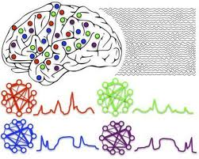
Integration of Neural Assemblies

Slide 24
Dynamic Interactive Temporal Cell Assemblies
Invariant Structure of Experience
Varela, Self-Organization
Bayes rule Pr(A|B)
Graph-models G(V,E)
Life-World
Metastable Structure

Slide 25
Experimental Neurophenomenology
First-person description of subjective experience.
Third-person data, for they record observations of biobehavioral phenomena made by scientist from their third-person perspective.

Slide 26
Waves of Consciousness
Time-consciousness has the phenomenal structure of a standing-streaming, an unceasing yet continually changing flow of moments of awareness.

Slide 27
Neurophenomenology and the Neural Correlates of Consciousness
D. Chalmers (2000) distinguishes between two types of neural correlates of consciousness:
NCC-neural corelates of background states of consciousness.
Content NCCs
The matching content doctrine

Slide 28
Problems with the Matching Content Doctrine
Noe and Thompson 2004: These correlates do not provide any case of a match between the content of a neural system and the content of a conscious state.
Rather, experience is intentional ”world-presenting”, holistic – constituted by interrelated perceptions, intentions, emotions, and actions. Intransitivily self-aware has a nonreflective subjective character.

Slide 29
Neurophenomenology
It derives from embodied dynamicism in its enactive version and thus does not assume the standard representationlist view of the brain.
Varela: Bodily activity in skilful coping sculpts the entire dynamical landscape of time-consciousness.

Slide 30
Necker Cube
The perception of the Necker Cube is a metastable dynamic structure rather than a building-block content.
Mind itself is a spatiotemporal pattern that molds the metastable dynamic patterns of the brain (Kelso, 1995)

Slide 31
Optical Illusions

Slide 32
Neurophenomenology and Naturalism
The synthesis of consciousness is completely different from the external combinations of natural elements…Instead of spatial mutual externality, spatial intermingling and interpretation, and spatial totality

Slide 33
Now-Phase Structure
ABC
Now-phase
Weight-function
Temporal flow of now-phases
A
B
C
Perceptual elements
t-1
t
t+1
time

Slide 34
Context and Temporal Objects
Now-phase structure
Now-phase structure
A C B
12 14 13
Bias=0.3
Bias=0.3
Feedback
Feedback
W1
W2
W3
W1
W2
W3
A
B
C
12
13
14
T-1
T
T+1
T-1
T
T+1
Weight function W1 < W2 > W3
Direction of the Attention Field
A
B
C
B
12 13 14
(e)
(e)
C

Slide 35
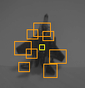
Temporal Synthesis and Anticipation
Focus of attention in the network is now pointing at this view
(e)
(a)
(c)
U1
U2
U3
U4
U5
Network of active units i.e. vision agents
(d)
(e)

Slide 36
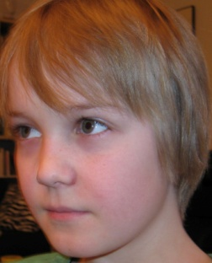
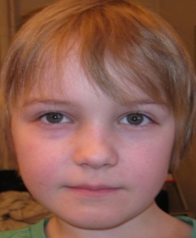
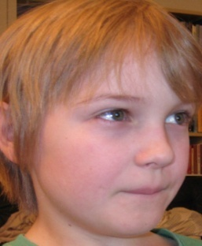
The Perceptual Synthesis is a Temporal Synthesis
A1
A2
A3
Affects
+ +
+ + + +
+ +
*Meaning
Actions
Motor Schemas and Movements
Touch
Classification of Histograms
Audio
Vision
Scale-Pyramid Representation
Gestalt Formation and Shape Integration Units
U1
U2
U3
Scale: S16
Increasing RF
Shape Filters Scale: S1
Filter Bank Scales: S1 – S16

