Slide 1
Iconicity in Language: The Emergence of Different Categories
CCS seminar, November 10 2011
Gerd Carling
Niklas Johansson

Slide 2
Basic questions
What role does iconicity play in language change?
Does iconicity disappear or emerge as a result of language change?
Does iconicity has the capacity to prevent or reorganize language change?
Can the postulation of a theory on iconicity in language change have consequences for the discussion on the origin and evolution of language?

Slide 3
Methodology: two-step procedure
Synchronic typology
Distinctions based on
Language structure
Frequency, statistical method
Apparent associations in a synchronic state
Comparison between unrelated languages
Diachronic typology
Distinctions based on
General observations in a historical perspective
Attested or reconstructed language change
Comparison between related languages

Slide 4
Iconicity : Basic distincions
Definition |  | References
Qualitative | Motivated connection between meaning and qualitative aspects of linguistic form
Quantitative | Motivated connection between meaning and quantitative aspects of linguistic form
Partial | Motivated connection between meaning and parts of lexemes
Full-word | Motivated connection between meaning and whole lexemes
Direct | Direct mapping of linguistic to non-linguistic sound, i.e., onomatopoeia | Masuda 2002, De Cuypere 2008
Indirect | Indirect correlation between meaning and linguistic form | Masuda 2002, De Cuypere 2008
Oppositional/ Relational | Motivated connection between a opposition/relation of meanings with linguistic forms | Carling to appear
Complex | Motivated connection between complex networks of meaning and linguistic form | Cf. De Cuypere 2008

Slide 5
Overlapping distinctions
Example: expressives in Kammu (Mon-Khmer) with information
on size of argument (Holmer & Tayanin, unpubl.)
1a yòn ò yɔ̀h càac-càac
father 1s go EXPR
‘My father walks with long steps’
2a páan kéey yɔ̀h cɛ̀ɛc-cɛ̀ɛc
mouse deer go EXPR
‘The mouse deer walks with long steps’
3a kɔ́ɔn ò yɔ̀h cʌ̀ʌc-cʌ̀ʌc
child 1s go EXPR
‘My child walks with long steps’

Slide 6
Semantic aspects of iconicity
Semantic domain | Semantic quality | Example, semantic node
Acoustic sound | Loud sound Ringing sound Noice
Physical property | Hollow form Slackness Long thin form Wetness Lightness Darkness | Cave-like Slimy Light, glowing Gloomy, blind
Size/Distance | Big/Small Proximal/distal | Proximal, medial, distal
Type of event | Swift movement Iterative movement Destruction Falling | Running, flying
Sense representation | Smell Taste Colour | Acid, sharp, soft Pleasant, unpleasant Darker, reddish
Evaluative attitude | Pejorative

Slide 7
Frequency code and iconicity (Based on Ohala 1994, Ahlner & Zlatev 2011, Johansson 2011)
Voicing | Voiceless sounds | Voiced sounds
F2 frequency | - | 2000< Hz |  |  | 1500-2000 Hz |  |  |  |  |  | 1000-1500 Hz |  |  |  |  |  | 500-1000 Hz |  |  |  | 500> Hz
Vowel Quality | - | i | y | e | ɛ | ø | æ | ɨ | a | œ | ə | ɶ | ɐ | ʉ | ʌ | ɤ | ɑ | ɒ | ɯ | ɔ | o | u
Consonant Quality | Voiceless consonants | Palatal voiced consonants
 |  |  |  |  |  |  | Dental voiced consonants
 |  |  |  |  |  |  |  |  |  |  | Velar voiced consonants
 |  |  |  |  |  |  |  |  |  |  | Labial voiced consonants

Slide 8
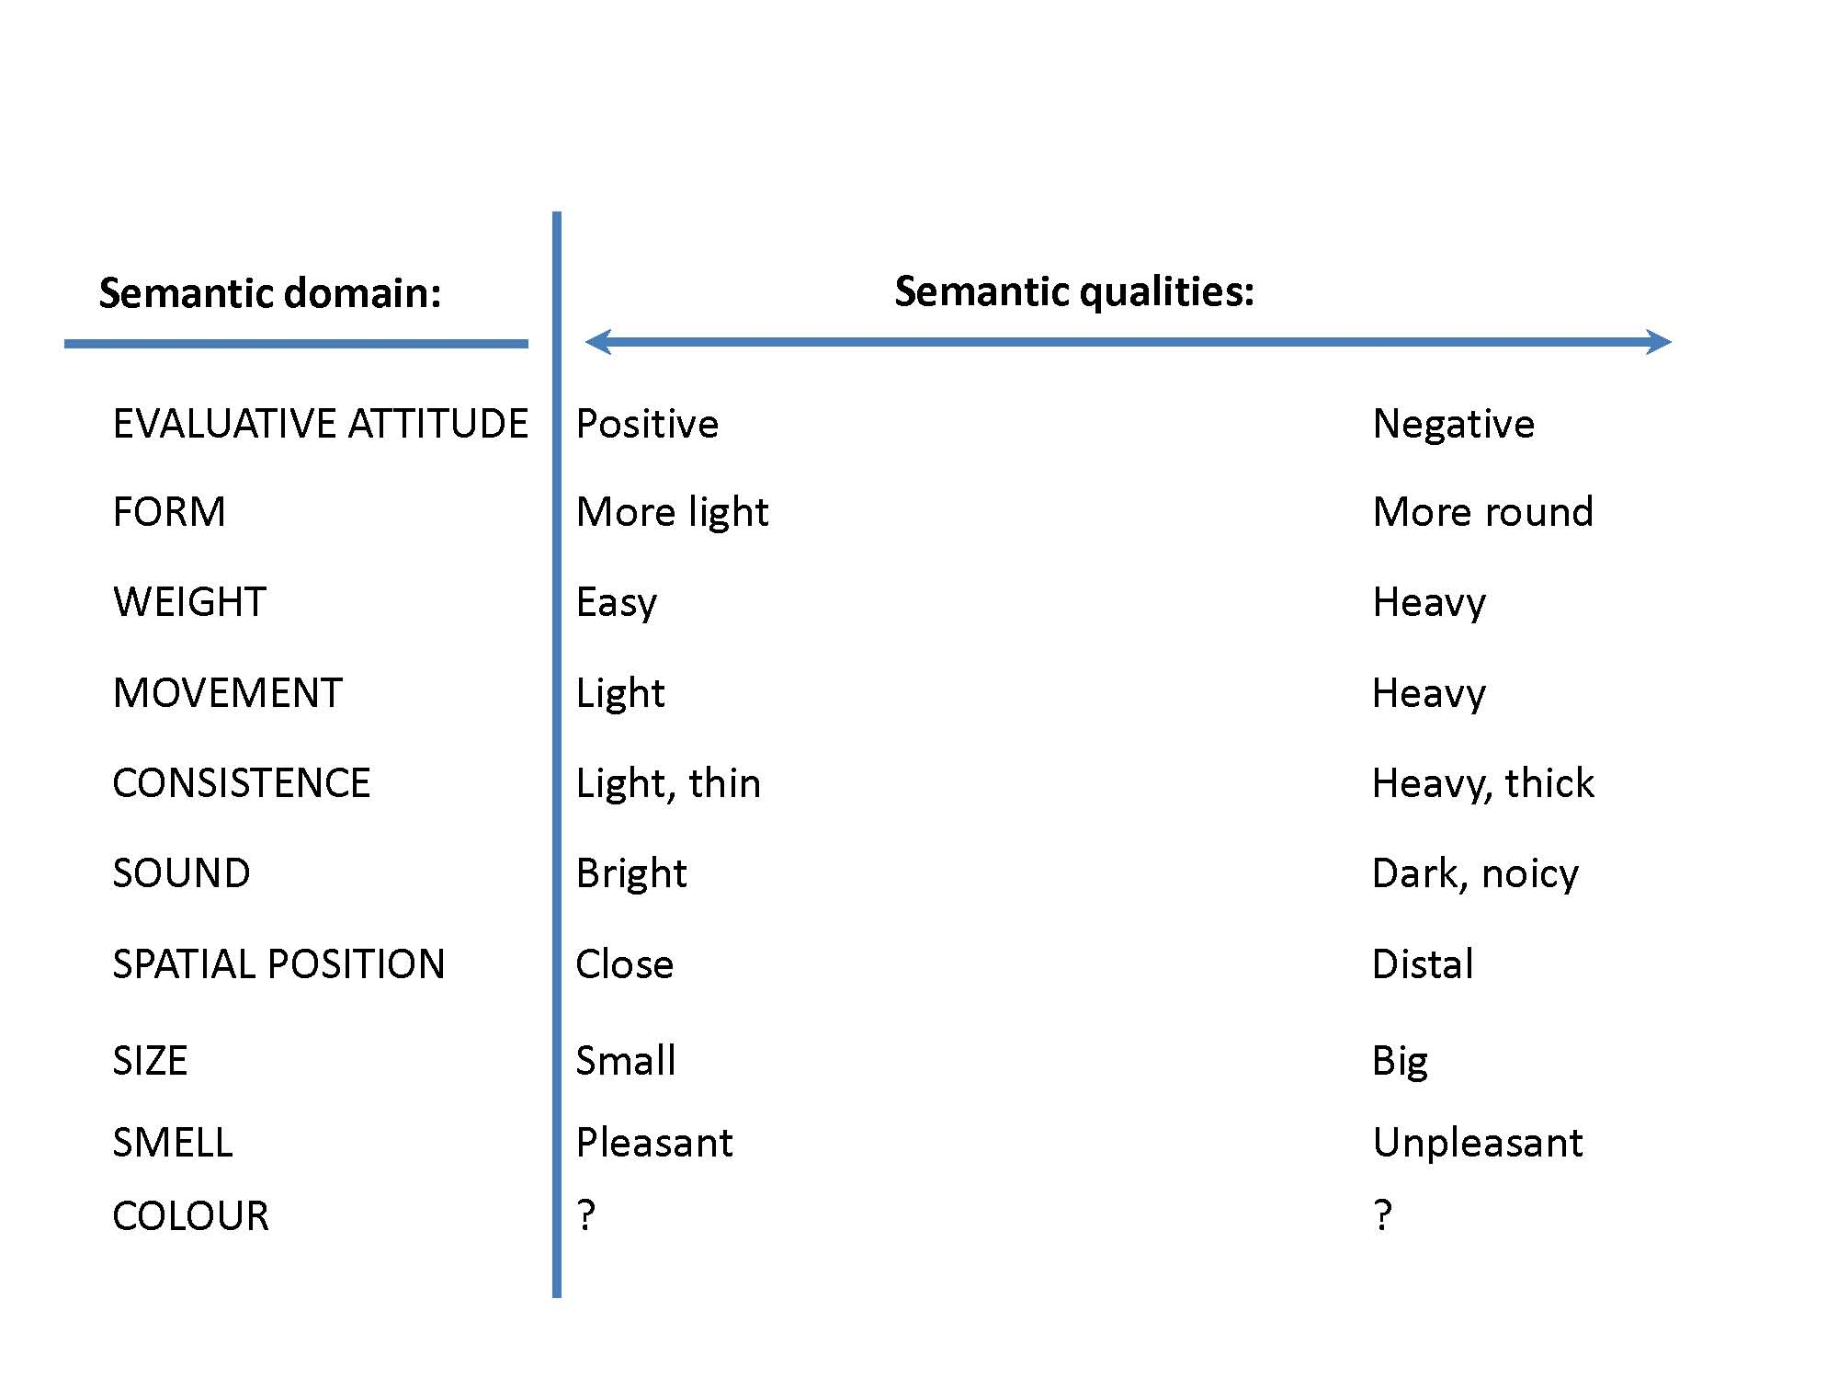
Semantic aspects: ”Coarseness principle”

Slide 9
Common types
Onomatopoeia
Direct, one-to-one, full-word
Lexical or non-lexical
Adapted (peep, tweet, meow) or non-adapted (atischoo, cock-a-doodle-doo)
Complex sound symbolism
Indirect, complex, normally partial
Normally adapted and lexical
Phonaestheme related to a certain meaning based on an association with similar phonaesthemes
Productive in network building

Slide 10
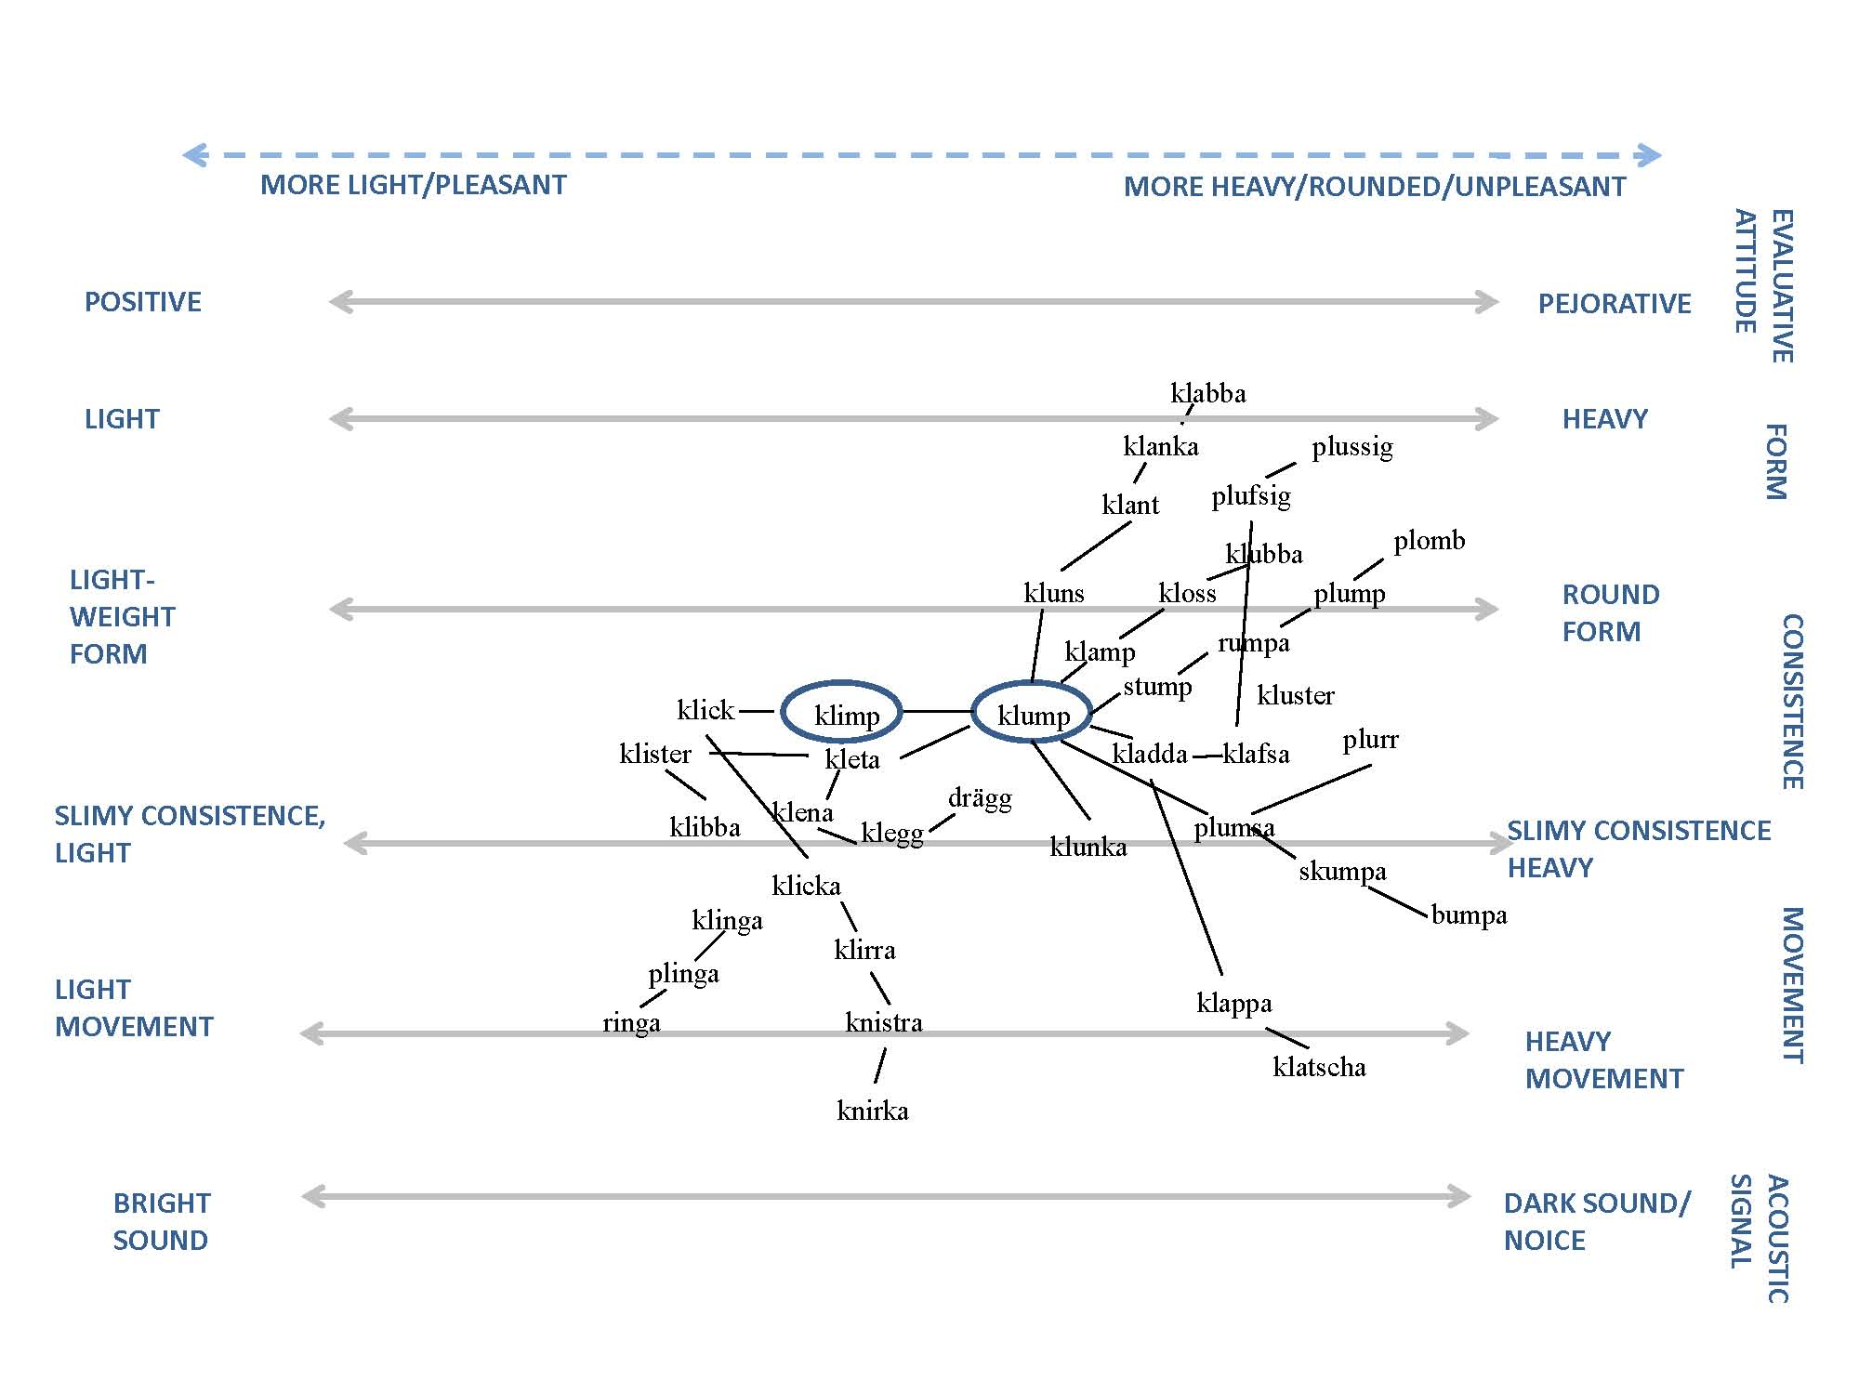
Sound symbolic network, based on Swedish

Slide 11
Continued…
3. Oppositional/relational iconic terms
Motivated connection between two or three meanings in language being in an oppositional or relational position and a corresponding opposition/relation of forms
Deictic terms, colour terms, big/small etc.
Nodes of sound symbolic networks are often oppositional/relational!
Frequency code most easy to measure here! (cf. Ohala 1994, Ahlner & Zlatev 2011, Johansson 2011)

Slide 12
4. Expressives/ideophones
”Marked words that depict sensory imagery” (Dingemanse 2011).
More frequent in some language areas.
Normally involve several iconic distinctions, i.e., fullword, partial, qualitative, quantitative, oppositional/relational.

Slide 13
Example, expressives in Semai (Tufvesson 2011)
Oppositional/relational, qualitative, partial
smell | colour | sound
gh_p ’acrid odour’ | ch_er ’red’ | gr_p ’crispy sound’
ghu:p ’acrid; neutral’ | che:r ’red’ | grɛ:p ’of chewing fruit’
gho:p ’acrid; intense’ | chɛ:r ’pink’ | gra:p ’of chewing crisps’
ghɒ:p ’acrid; very intense’ | chɨ:r ’orange’ | grɨp ’of chewing cassava’

Slide 14
Emergence of onomatopoeia
Well-defined semantic notions (words for animals with a distinct call: crow, cockoo, owl, words that are acoustic imitations: crash, boom, bang)
Emergence: (attempt towards) direct imitation
Change:
Resistance to adaption and change, e.g., atischoo, cock-a-doodle-doo
Adaption without change, e.g., Middle English pipen, Modern English peep (cf. McMahon 1994)
Adaption with change (de-iconization), Swedish gök, Middle High German gouh < Proto-Germanic *gauka (iconic, imitative)

Slide 15
Indo-European ’owl’
*ulul-
Indo-European *ulūkos
*uw-
Old Indo-Aryan úlūka-
Proto-Germanic *ūwilōn
Latin ulucus
Icelandic ugla
English owl
Latin būbō
Swedish uggla
German Eule
Greek býās
Armenian bu
German Uhu
German (dial.) Buhu

Slide 16
Emergence of complex sound symbolism: case study on Germanic
Basic issues:
Principles of lexical coining (=emergence)
Principles of language change (form/meaning) (=spread, decay)
Material:
Phonaesthemes gl-, fl-, bl-, kl- (all languages)
Swedish fj-, -mp
Imitative verbs (Germanic and English)

Slide 17
Example: Initial fj- in Swedish
WORD | MEANING | ETYMOLOGY | Earliest attestation
fjant | busybody | From Rotwelsch/Bavarian fant ‘Knabe, Bube’ | Attested from end of 19th ct.
fiasko | failure | From Italian fiasco ‘bottle with flat bottom and long neck’ | Attested from end of 19th ct.
fjollig | foolish | From Old French fol | Attested from end of of 18th ct.
fjompig | show off | Variant of fjollig? | ?
fjuttig | insignificant | Variant of futtig (same meaning), probably from German futsch ‘away, in vain’ (onomatopoetic) | Futtig from end of 18th ct.
fjäska | fawn on | Earlier meaning ‘hurry without doing anything’, probably variant of fjäsa (same meaning) of uncertain origin | Attested in this meaning since 18th ct.
fjärta | fart | Germanic word with Indo-European roots, Old English feortan, etc. | Attested from 16th ct.
fjoskig | dotty | Variant of fnoskig, uncertain origin | Attested from 18th ct.
fjälla | girlfriend, prostitute | From argot (knoparmoj), origin unknown | Attested from early 20th ct.

Slide 18
Emergence of sound symbolism: lexical coining by means of …
Direct emergence. Obvious association with an acoustic signal, e.g., crack, tap, smack, plop, warble, wheeze.
Structural emergence. Emergence by means of a given structural precondition, following the frequency code and coarseness principle, e.g., klimp ~ klamp ~ klump.
Analogical emergence. Emergence by means of other linguistic material in the language, e.g., flit, flip, flicker, fleet, most fj- and -mp constructions in Swedish.
Overlapping with structural emergence!

Slide 19
Creation of sound symbolic networks by means of …
Productivity of derivation, e.g., of a particular root, in the case of gl-, Indo-European *g’hel- (more than half of the gl-words in Germanic languages are derivations from this root).
Sporadic phonetic substitution or retention. E.g., Swedish/Norwegian glam < *hlam.
Influx and adaption of loans, e.g., Swedish glas, glans, glykol, English glair,
Semantic change. Most frequent on loanwords. Often difficult to judge whether the change is related to iconicity, e.g., glass, glaukom, glycerin, glottis <(Greek tongue)

Slide 20
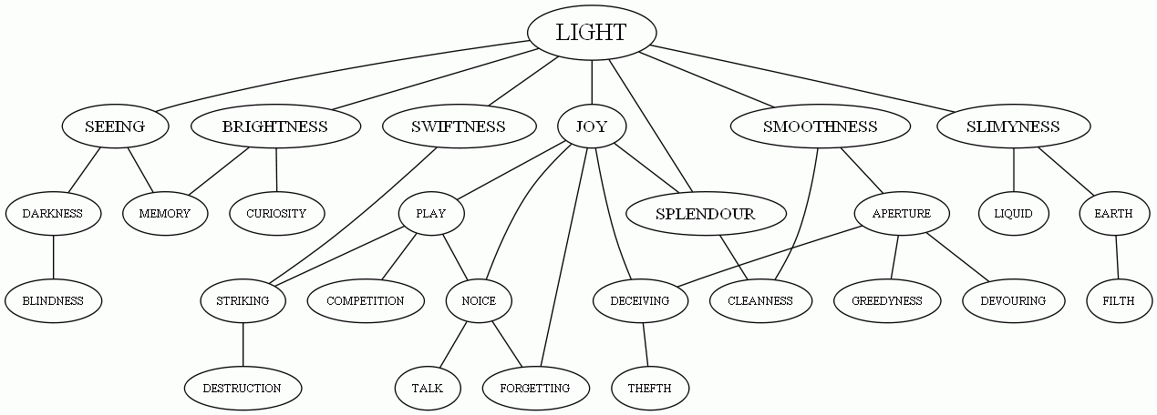
Synchronic /diachronic semantic network of gl-words in Germanic languages Paths based on attested semantic change

Slide 21
Emergence and change of oppositional/relational iconicity
Basic principles same (frequency code/coarseness princple)
Conditions different
Limited set of forms
Distinct functional categories

Slide 22
Deictic terms in Indo-European languages
Data: PIE deictic system ≠ daughter languages’ systems
Iconicity (F2 frequency) present in spatial deixis in many of the world’s languages Ultan (1978), Woodworth (1991), Traumüller (1994), Johansson (2011)
Could this mean that the actual rebuilding is influenced by iconicity?
Does the contrast between deictic terms reappear?
Questions:
How are deictic systems rebuilt?
Does iconicity appear and re-appear throughout history?

Slide 23
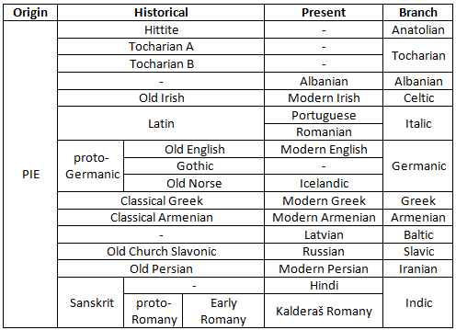
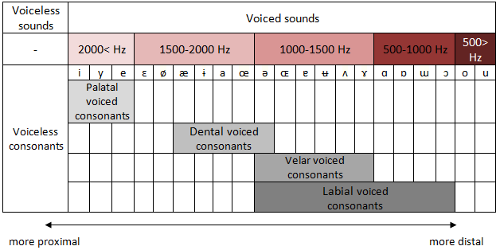
Method and material
30 Indo-European languages, 13 contemporary and 17 historical, 12 branches
Alternatives:
Iconic (fulfilling the expected relation between deictic form and sound value)
Non-Iconic (arbitrary)
Reversed-Iconic (the reverse of motivated, perhaps functionally)

Slide 24
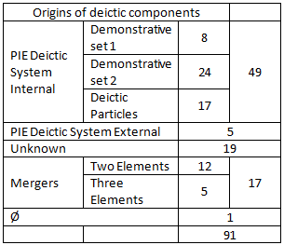
Results and Discussion
5 strategies of rebuilding, mostly using of internal material from the PIE deictic system
High Iconic support

Slide 25
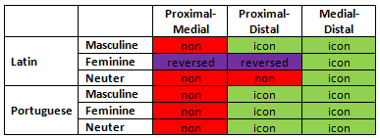
Results and Discussion
Genetic explanations excluded due to the different ways of rebuilidng deictic material
A slightly higher support for Reversed-Iconic than Non-Iconic, possibly deliberate
Classical Greek οὗτος - ἐκεῖνος
Modern Greek τούτος – εκείνος
Proximal and Medial vs. Distal?

Slide 26
Results and Discussion
Choosing fitting, iconic, forms
Iconicity despite reformation of systems
Iconicity despite reinvention of systems
Russian forms э́тот, тот completely rebuilt, cf. OCS сь, онъ
Icelandic forms þessi, þetta have become distance-neutral

Slide 27
Conclusion
Despite the various strategies of creating new deictic forms, 75,43 % iconic
Iconicity seems to be reintroduced after the decay of a former deictic system
Very likely that iconicity is involved in the rebuilding of deictic material, perhaps for other language families as well

Slide 28
Brief summary…
Languages change, which results in
iconic patterns being blurred
iconic words being conventionalized and subdued to change
BUT:
Iconicity renews itself continuously, using a rich variety of strategies for emergence and change.
Conditions different depending on type!
Some types are more productive in some languages.

Slide 29
Further consequences?
Cross-modality perspective:
When iconicity is created or reintroduced, the frequency code and coarseness principle seem to be of main importance (cf. Sound symbolism and deixis!).
Origin of language perspective:
Emergence of iconicity follows 3 basic principles:
Direct emergence: correlation with outside world (referent)
Structural emergence: correlation with cross-modalities
Analogical emergence: correlation with language-internal structures

Slide 30
Direct emergence
Outside
World
Ontological categories, acoustic production
Language
Linguistic
sign
Speaker
Multi-modalities
(gesture, speech production, perception)

Slide 31
Structural emergence
Outside
World
Ontological categories, acoustic production
Language
Linguistic
sign
Speaker
Multimodalities
(gesture, speech production, perception)

Slide 32
Analogical emergence
Outside
World
Ontological categories, acoustic production
Language
Linguistic
sign
Speaker
Multimodalities
(gesture, speech production, perception)

